Slide 1


05
Combinatorial Games
Samuel Lukas
Introduction Game Theory and Its Applications
Elliott Mendelson, CRC Press Company, Washington DC.2004

Slide 2
Definition
The characteristics of Combinatorial games
There are only two players
It is deterministic or No random moves
It is finite : a finite number of moves
Perfect Information : every moves by one player is known to the other player
It is a zero sum game
Tic-tac-Toe game

Slide 3
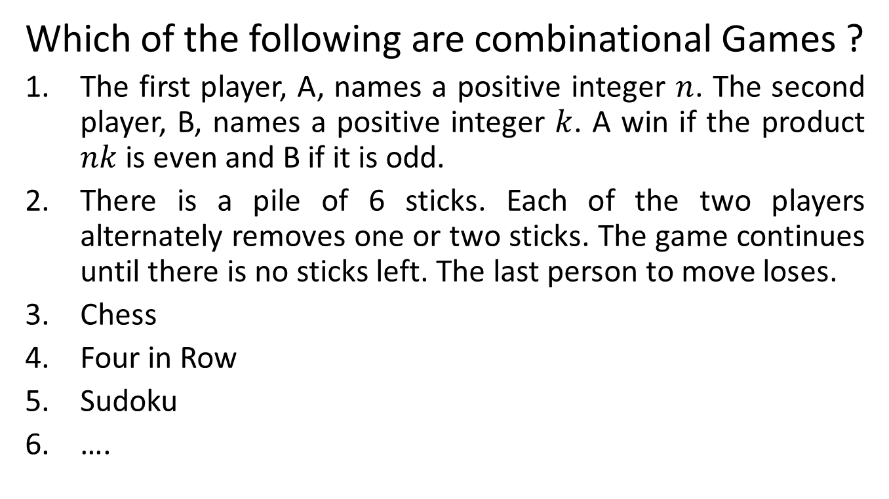
Examples 01
Which of the following are combinational Games ?
The first player, A, names a positive integer $n$. The second player, B, names a positive integer $k$. A win if the product $nk$ is even and B if it is odd.
There is a pile of 6 sticks. Each of the two players alternately removes one or two sticks. The game continues until there is no sticks left. The last person to move loses.
Chess
Four in Row
Sudoku
….

Slide 4
Strategies in CG
Winning Strategy is a strategy that makes a player wins the game.
Non-losing strategy is a strategy that makes a player will not lose the game.
In any combinational game, at least one of the players has a non-losing strategy
In any combinational game, either one player has a winning strategy or both players have non-losing strategies

Slide 5
Tic-Tac-Toe Game
Non-losing strategy in 3 x 3 Tic-Tac-Toe Game
O
X
O
X
O
O
 | x
X
X
O
O
X
X
X
O
X
X
X
O
Does the player have a winning strategy in this Game ?

Slide 6
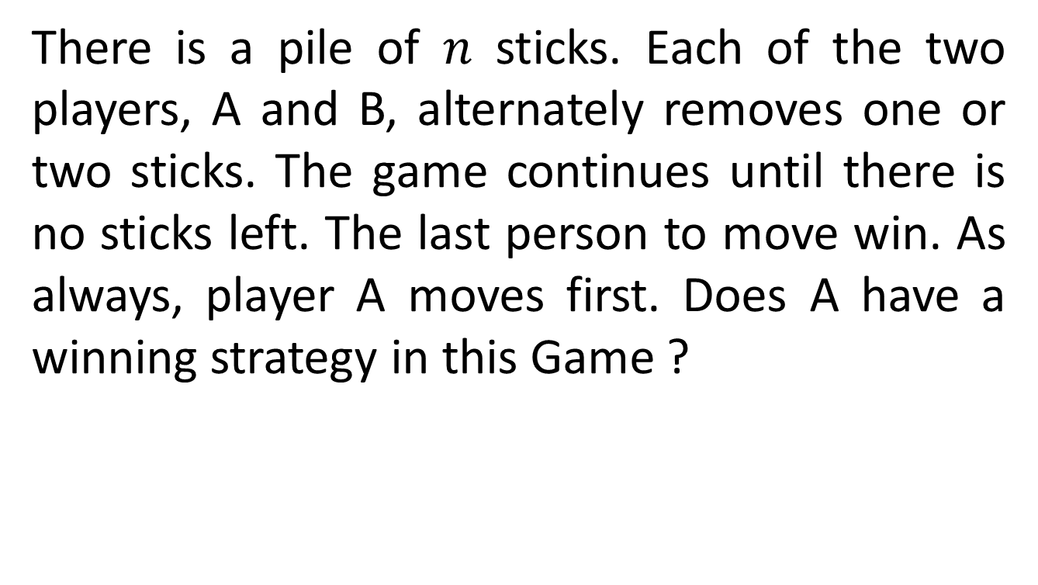
Removal Games
There is a pile of $n$ sticks. Each of the two players, A and B, alternately removes one or two sticks. The game continues until there is no sticks left. The last person to move win. As always, player A moves first. Does A have a winning strategy in this Game ?
Suppose there are 13 sticks. A starts by removing one stick, leaving 12 sticks and whenever B removes one stick then A will remove 2 sticks but if B removes two sticks, A follows by removing one stick. It means the number of sticks left is always multiple of 3. B will not be the last person to move. So this is the winning strategy of A

Slide 7
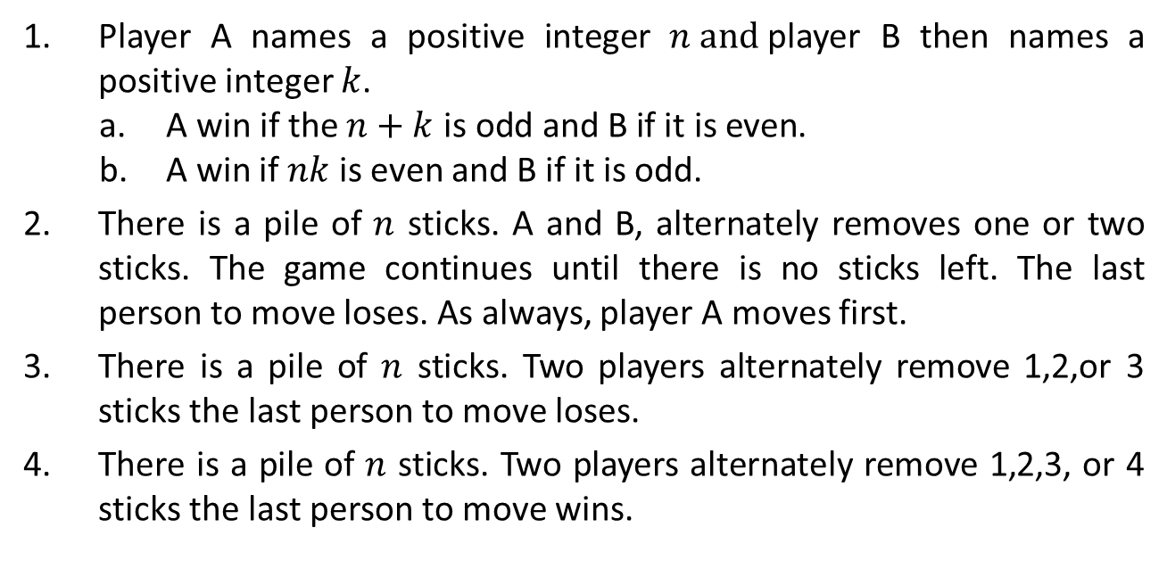
Exercises
Find a winning or non-losing strategies of these games
Player A names a positive integer $n and$player B then names a positive integer $k$.
A win if the $n+k$ is odd and B if it is even.
A win if $nk$ is even and B if it is odd.
There is a pile of $n$ sticks. A and B, alternately removes one or two sticks. The game continues until there is no sticks left. The last person to move loses. As always, player A moves first.
There is a pile of $n$ sticks. Two players alternately remove 1,2,or 3 sticks the last person to move loses.
There is a pile of $n$ sticks. Two players alternately remove 1,2,3, or 4 sticks the last person to move wins.
B wins
A wins
B wins

Slide 8
An 8 x 8 checkerboard contains 64 one-inch squares. Two players take turns covering two adjacent squares with 1 x 2 inch dominoes. The game is played until no further move is possible. The last person to move is the winner.
Consider 25 sticks are arranged In a 5 x 5 square. Players alternately take any number of sticks from a single row or column. At least one stick must be taken. There is an additional restriction that a group of sticks can not be taken in one moves if there is a gap between the sticks. The last person to move win.
From an ordinary deck cards, the spades from the ace to the nine are placed on a table. Two players choose in turn from these cards. A card has been chosen, cannot be chosen again. A winner is the first player to get three cards adding up to fifteen.
B wins
A wins
Non-losing strategy
2 | 7 | 6
9 | 5 | 1
4 | 3 | 8
Use this magic square

Slide 9
Game of Nim / Take
At the beginning of a game of Nim, there are one or more piles of objects. Different piles may contain different numbers of objects. The player alternately remove one or more objects from one of the piles (all of the objects in that pile may be taken). The last person to move wins.
Example First pile : x x
Second pile : x x
B has winning strategy ?
if A takes both objects from the first pile, then B removes both object from other pile.
If A takes one object from a pile. Then B takes one object from the other pile.

Slide 10

A game of Nim,
first file : x x x : $2^{1}+2^{0}$
second pile : x x : $2^{1}$
Third pile : x x x : $2^{1}+2^{0}$
9. First file : x x x x x : $2^{2} +2^{0}$
second pile : x x x : $2^{1}+2^{0}$
Third pile : x x x x : $2^{2}$
Fourth pile : x x : $2^{1}$
The power of 2 occurs an odd number
unbalance collection
A wins
B wins
the power of 2 occurs an even number
balance collection
If a player confronts a balance collection, the new collection after that player moves must be unbalanced. However, If a player confronts an unbalance collection, that player can make a move in such away that the new collection is balanced.
If the origin collection is unbalanced then the first player, A, has a winning strategy. On the other hand, if the origin collection is balanced then the second player, B, has a winning strategy.

Slide 11
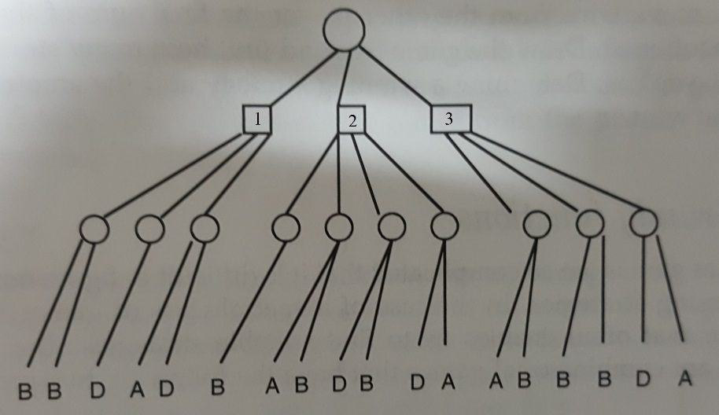
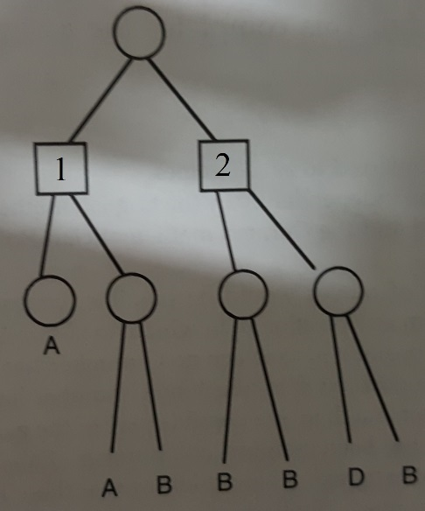
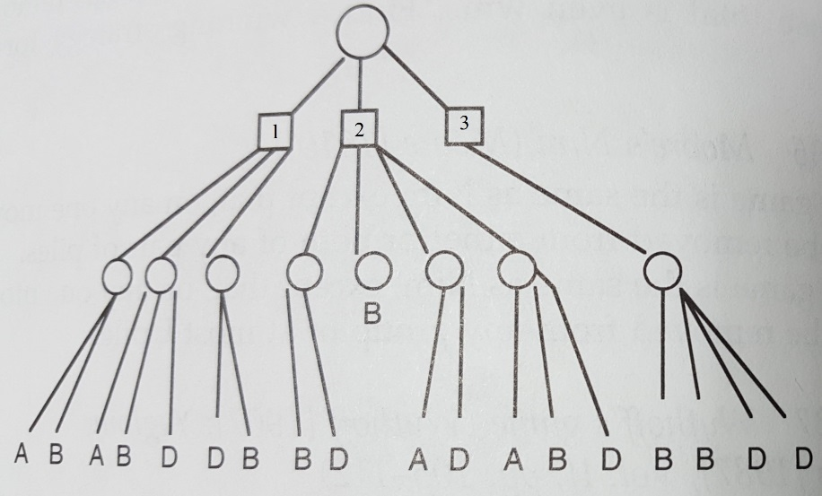
Analyzing Game using Tree
Circle indicates a possible move for B
Square indicates a possible move for A
B has a winning strategy
A has a winning strategy.
That is 1
Non-losing position for both player why

Slide 12
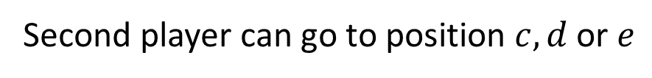
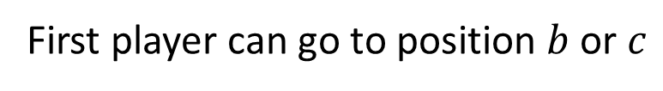

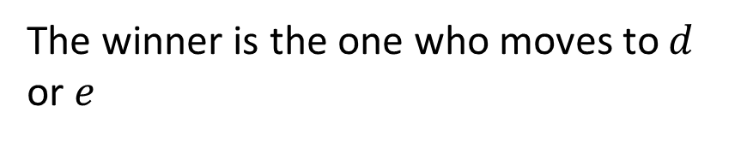
Grundy Functions
A technique enables us to find suitable strategies to win a special combinational games that have two properties
The last person to move wins
At each position, there are only a finite number of allowable moves
a
Current condition is position $a$ and
First player can go to position $b$ or $c$
b
c
Second player can go to position $c, d$ or $e$
The winner is the one who moves to $d$ or $e$
d
e
Second player will win the game
How can Grundy function analyse this condition ?

Slide 13
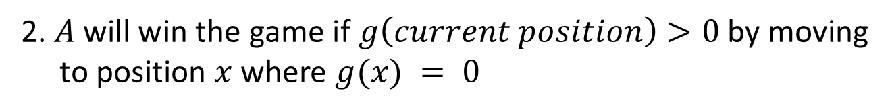
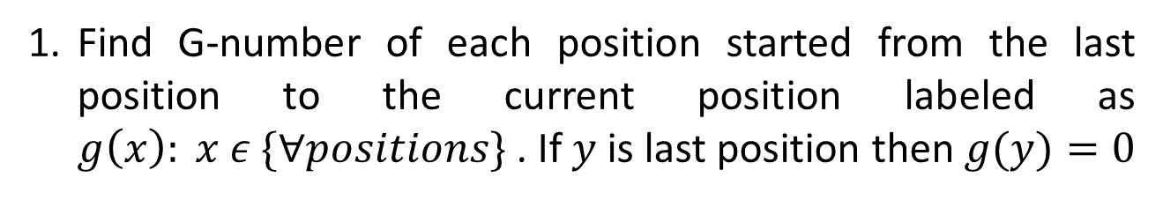
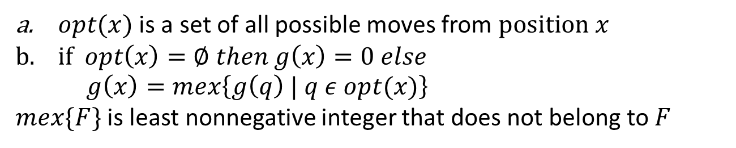
Grundy Functions Procedure
Find G-number of each position started from the last position to the current position labeled as $g\left(x\right): x ε \{∀positions\}$. If $y$ is last position then $g(y)=0$
$opt(x)$ is a set of all possible moves from $position x$
$if opt\left(x\right)=∅ then g\left(x\right)=0 else$
$g\left(x\right)=mex\left\{g\left(q\right) | q ε opt(x)\right\}$
$mex\{F\}$ is least nonnegative integer that does not belong to $F$
2. $A$ will win the game if $g\left(current position\right)>0$ by moving to position $x$ where $g(x) = 0$

Slide 14




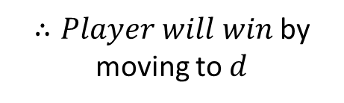


Example 02
a
$$g\left(e\right)=0$$
$$g\left(d\right)=0$$
$$opc\left(c\right)=\left\{d,e\right\}→g\left(c\right)=mex\left\{g\left(d\right),g\left(e\right)\right\}=mex\left\{0\right\}=1$$
b
c
$$opc\left(b\right)=\left\{c,d\right\}→g\left(b\right)=mex\left\{g\left(c\right),g\left(d\right)\right\}=mex\left\{0,1\right\}=2$$
$$opc\left(a\right)=\left\{b,c\right\}→g\left(a\right)=mex\left\{g\left(b\right),g\left(c\right)\right\}=mex\left\{1,2\right\}=0$$
d
e
$$∴Player will lose$$
a
$$g\left(f\right)=0$$
$$opc\left(e\right)=\left\{f\right\}→g\left(e\right)=mex\left\{0\right\}=1$$
b
c
d
$$opc\left(b\right)=\left\{e,f\right\}→g\left(b\right)=mex\left\{0,1\right\}=2$$
$$opc\left(c\right)=\left\{b,f\right\}→g\left(c\right)=mex\left\{2,0\right\}=1$$
e
f
$$opc\left(d\right)=\left\{c\right\}→g\left(d\right)=mex\left\{1\right\}=0$$
$∴Player will win$ by moving to $d$
$$opc\left(a\right)=\left\{b,c,d\right\}→g\left(a\right)=mex\left\{2,1,0\right\}=3$$

Slide 15
Trick base on Binary decompositions
1
8
9
10
11
12
13
14
15
2
4
5
6
7
12
13
14
15
3
2
3
6
7
10
11
14
15
4
1
3
5
7
9
11
13
15
A has to think any number between 1 and 15, and then player B will ask A whether that number appears in this column after asking four times.
Then B will know the unknown number of A. How can it be ?
Suppose A think 11, then A said yes, no yes and yes then B answers the number is 11
How would B extend the table so that he can guess any unknown number between 1 and 31 ?

Slide 16
Hex Games
White uses white token to construct a continuous chain of white tokens connecting white’s edges (top and the bottom of the board) where as Black from left to the right. Two tokens are adjacent in a chain must be in hexagons having a common edge.

Slide 17
Black Wins
Red Wins
Assuming white moves first, How can white have a winning strategy for 4 x 4 Hex ?
First move is in principle diagonal
Is it possible to have a draw in Hex ?
No

Slide 18
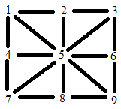
Exercises
Starting with a collection of 27 objects. Two players alternately remove from 1 to 4 objects at a time until all objects have been removed. Each player then counts the total number of objects that he has removed. The player whose total is even wins. Find a winning strategy for the first player.
2.
As in Tic-Tac-Toe is to place three of your own token in a straight line. However, each player is allowed to put down only three tokens. Thereafter, instead of placing more tokens, each player moves one token along a straight line to an adjacent unoccupied position. Show that both players have non-losing strategies.

Slide 19
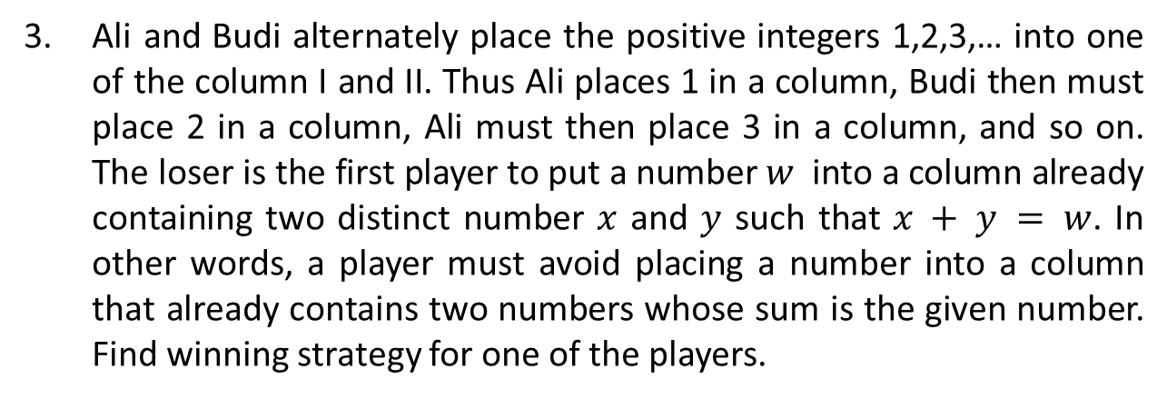
3. Ali and Budi alternately place the positive integers 1,2,3,… into one of the column I and II. Thus Ali places 1 in a column, Budi then must place 2 in a column, Ali must then place 3 in a column, and so on. The loser is the first player to put a number $w$ into a column already containing two distinct number $x$ and $y$ such that $x + y = w$. In other words, a player must avoid placing a number into a column that already contains two numbers whose sum is the given number. Find winning strategy for one of the players.
4. Consider a tape divided into cells of equal size. Let a move consist of placing a domino on two adjacent cells. No domino is allowed to overlap any previously placed domino. Let us find winning moves (if any ) for the following tape domino positions
a.
b.

